Slide 1
PLACE Tool Kit
Protocol Decisions
Presentation to the PLACE National Steering Committee
Presenter name and degree here
Your organization here
f
Date of presentation
Name of meeting
Notes:
This is a long presentation. When used for trainings, see the agendas associated with the Priorities for Local AIDS Control Efforts (PLACE) Fieldwork Implementation Guide to plan breaks for participants. The guide is in the PLACE Tool Kit, available online here: https://www.measureevaluation.org/resources/tools/hiv-aids/place.

Slide 2
Protocol Section |  | Decisions
1 | Summary | Time frame, project scope
2 | Aim, rationale, specific objectives | Tailoring PLACE objectives based on strategic information gaps
3 | Engagement and organizational structure | Plan for stakeholder engagement
4 | Study location and mapping | Where to implement PLACE
5 | Readiness assessment | Whether PLACE can be implemented safely
6 | Study design | Defining survey populations and consent process
7 | HIV testing | Which tests, the testing protocol
8 | Quality assurance and training | Specify quality checks
9 | Sampling and sample size | Forms A, B, and C
10 | Key indicators | Forms A, B, and C, variable lists
11 | Statistical analysis | Methods, weighting
12 | District reports | Data use
Notes:
Here’s a list of all the parts of the PLACE Protocol Decisions Manual, each of which will be discussed during this presentation. See Table 1 of the manual for a more complete breakdown of what tools are provided with the PLACE method manuals, and where they can be found. The manual is in the PLACE Tool Kit, online here: https://www.measureevaluation.
org/resources/tools/hiv-aids/place. The Sample Protocol, which the Protocol Decisions Manual supports, is also in the tool kit, online.

Slide 3
1. Study Summary

Slide 4
Study summary
The study summary (1 page) provides key information to stakeholders. It will be based on the protocol decisions, and will cover the following:
Study aim
Study areas: Where PLACE will be implemented
Study design and methods
Number and type of participants
Key outputs and indicators
Study leadership and funding
Note: It is completed AFTER protocol decisions are made.

Slide 5
Worksheet 1.1. Study Summary and Time Frame
Study Title | The 2019 PLACE Study in Carolina.
Aim | To increase local capacity to understand the drivers of local HIV epidemics, identify gaps in services among those most likely to acquire and transmit HIV, and provide evidence to support tailored interventions to reduce HIV transmission and improve access to treatment.
Objectives | <Insert specific objectives.>
Study Areas | <Insert list of selected districts>
Study Design: The 5 Steps of Fieldwork | District launch and identification of Priority Prevention Areas Venue Identification Venue verification, profiling, and mapping Bio-behavioral survey Feedback and data use workshop
Methods | Stakeholder input Community informant interviews Programmatic mapping Bio-behavioral surveys HIV testing and viral load estimation Data use workshops
Participants per District | 10-50 district stakeholders 300 community informants 300 venue informants 90 venue workers 600 venue patrons
Total Expected Number of Key Populations | <Insert expected number of key populations.>
Outputs in Each District | Priority Prevention Areas identified Complete list of public venues where people meet new sexual partners Complete list of public venues where people who inject drugs can be reached Venue maps and profiles Estimates: HIV prevalence, HIV transmission and acquisition risk, program coverage, prevention and treatment cascades, and key population size Action plans based on the data.
Key Coverage and Bio-Behavioral Indicators Provided | <Insert list of indicators.>
Leadership and Funding
National Level | The PLACE National Steering Committee chaired by: Name, Organization, Address, Contact details, telephone, email | The PLACE National Steering Committee chaired by: Name, Organization, Address, Contact details, telephone, email
Local Level | The District Steering Committee in districts where PLACE is implemented | The District Steering Committee in districts where PLACE is implemented
Implementation | Name, Organization, Address, Contact details, telephone, email | Name, Organization, Address, Contact details, telephone, email
Other | Organizations, Address, Contact details, telephone, email | Organizations, Address, Contact details, telephone, email
Funding | Organization | Organization
Notes:
This worksheet and all others referenced in this slide deck are in Appendix A of the PLACE Protocol Decisions Manual.

Slide 6
2. Aim, Rationale, and Objectives

Slide 7
Review aim
The aim of the Priorities for Local AIDS Control Efforts (PLACE) method is to increase local capacity to understand the drivers of local HIV epidemics, identify gaps in services among those most likely to acquire and transmit HIV, and provide evidence to support tailored interventions to reduce HIV transmission and improve access to treatment.

Slide 8
Review and confirm objectives
To identify “priority prevention areas” (PPAs)
To identify public social venues where people meet new sexual (or needle-sharing) partners
To visit, describe, map, and assess the availability of HIV prevention services at these venues
To measure indicators of HIV infection status, population size, transmission risk, and access to HIV prevention and treatment services among key and priority populations at venues
To estimate HIV prevention and treatment cascades
To engage with local stakeholders to use the data to improve programs

Slide 9
Terms used in setting objectives
Priority prevention areas: Geographic areas expected to have higher incidence of HIV
Key population: Populations most at risk of acquiring and transmitting HIV by sex or needle sharing
HIV treatment cascade: A bar graph of the number of people who are HIV-positive and on treatment, and who have achieved viral suppression
HIV prevention cascade: Bar graphs showing the number of those who need HIV prevention services, the number who have access to services, and the number who use the service consistently

Slide 10

Prioritize key indicators and subgroups
Indicators
HIV prevalence
Population size
HIV treatment cascades
HIV prevention cascades
Risk behavior and program coverage
Subgroups
Men
Women
Female workers
Youth 15-24
Female sex workers*
Men who have sex with men (MSM)*
People who inject drugs*
Transgender women*
Others
* May require oversampling for precise estimates
Notes:
Blue check indicates PLACE will always cover these groups. Oversampling may be required for the other groups.

Slide 11
Tool to clarify rationale and objectives
Purpose of “Worksheet 2.1. PLACE Objectives: Identification of Gaps that PLACE Could Address”
To specify the rationale for PLACE
To identify the gaps in strategic information that the PLACE study could address.
To specify objectives based on the gap analysis.

Slide 12
How to set priorities for PLACE
Use Worksheet 2.1 to set priorities for PLACE
Review the strategic information question and determine if there is a gap.
Review the relevant PLACE objectives and determine if each one is high-, medium-, or low-priority.
Reach consensus on whether the objective should be included.

Slide 13
Example: Where is HIV transmission most likely to occur ?
Do you know in which areas in the country HIV transmission is most likely to occur?
If there is a gap in strategic information, do you want to identify priority prevention areas in the country using the PLACE method?
If the answer is yes, can you confirm this objective of the PLACE study?
There are 7 questions to answer on Worksheet 2.1. Answering these questions will shape the PLACE protocol.

Slide 14

Small-group work
Everyone should review the questions on Worksheet 2.1 and answer for each area:
  Whether the topic is a gap
  What the priority is for addressing the gap (high, medium, or low)
Come back together to discuss your responses and confirm the objectives.

Slide 15
3. Engagement and Organizational Structure

Slide 16
Stakeholder documentation
To clarify study leadership, establish an ethical review process, and document stakeholder engagement to ensure full engagement of all affected people, including key populations and priority populations
Worksheets
3.1 Stakeholder Engagement
3.2 National Steering Committee Members
3.3 Core Implementation Team Members
3.4 District Steering Committee Members
3.5 District PLACE Study Team Members

Slide 17
Identify leadership
Describe the recommended organizational structure that will be used for PLACE implementation and describe the role of the National and District Steering Committees and their members.
National Steering Committee
National Consultations
Key Population Groups
Service Delivery Providers
Ethical Review Committees
Core Implementation Team
Epidemiology, M&E, GIS Units
District Fieldwork Teams
District Steering Committees
District Stakeholders
Notes:
Action: Edit the figure, as necessary. Ask the National Steering Committee for any other recommendations for the committees.

Slide 18
National Steering Committee
The National Steering Committee oversees the design and implementation of PLACE, and the dissemination of the findings. The National Steering Committee is established in collaboration with government, funding organizations, and stakeholders.
Members are representatives from civil society, nongovernmental organizations, donors, people conducting surveillance, and advocacy groups.
Notes:
Use Worksheet 3.1 to document stakeholder engagement.

Slide 19
National Steering Committee members
Use this slide to identify the names of the National Steering Committee members.
Name 1
Name 3
Name 2

Slide 20
Core Implementation Team leadership
Name 1
Name 3
Name 2
Notes:
Use this slide to identify the names of the Core Implementation Team

Slide 21
Ethical review process
Engagement includes engagement with ethical and technical review committees.
List committees that will formally review the protocol. This may include scientific review as well as ethical review.
Plans for seeking ethical review should be described now.
It may be appropriate to request an exemption from full ethical review if the findings will be used primarily for program improvement.

Slide 22
Ethical implementation
Even if the protocol is exempt from full ethical review, ethical implementation requires the following:
That potential participants are given information about the study, including the risks and benefits of participation
That participation is voluntary and can be stopped at any time
That HIV test results are provided along with linkage to care, if indicated
That maps and data are stored securely, and the confidentiality of participants is honored

Slide 23
4. Study Location and Mapping

Slide 24
Where to implement PLACE?
Background: In preparation for this National Steering Committee meeting, the Core Implementation Team will have identified the geographic framework for the country and met with key people to synthesize HIV epidemic indicators in a spreadsheet.
Key strategic indicators may have already been mapped using the PLACE QGIS software or some other spatial analysis tool.
The data and maps are used to better understand the drivers of the HIV epidemic, select areas to implement PLACE, and provide a spatial platform to interpret PLACE results and to create coverage maps.
Notes:
The PLACE QGIS software is available on MEASURE Evaluation’s website, here: https://www.measureevaluation.org/resources/tools/hiv-aids/place/place-method/the-place-mapping-tool-a-plug-in-for-gis.

Slide 25
Overview
Review Sample Protocol, Section 4.
Identify and document the geographic framework.
Obtain spatial data for administrative levels.
Compile district-level surveillance, population, and program data in the district summary spreadsheet.
Review contextual factors to identify a typology of priority prevention areas (PPAs).
Produce district-level maps.
Select areas to implement PLACE.

Slide 26
Adapt geographic framework
Country: name
Metropolitan districts
Subdistrict divisions
Other districts
Subdistrict divisions
Region(s)
The framework should be adapted to the country and should include the administrative areas in purple. This example is for a study that will select districts (both metropolitan districts and others).
Notes:
This framework should be updated to reflect the country situation. See Worksheet 4.1: The Geographic Framework, Appendix A in the Protocol Decisions Manual.

Slide 27
Obtain spatial data (the “shapefiles”) for administrative levels
Consult with spatial analysis experts to obtain spatial data for the country.
The PLACE QGIS tool contains information for 14 selected countries:
Angola
Burundi
Côte d’Ivoire
Democratic Republic of the Congo
Eswatini (formerly Swaziland)
Ghana
Haiti
Kenya
Malawi
Mozambique
Rwanda
South Africa
Tanzania
Uganda

Slide 28
Compile and map district-level epidemiologic and program data
Compile available district-level surveillance of population and routine program indicators, including:
HIV prevalence, by age, sex, and population group
Prevention of mother-to-child transmission (PMTCT) prevalence estimates for pregnant women
Number of people living with HIV, syphilis, and tuberculosis
Number on antiretroviral therapy (ART)
Number on ART not achieving viral suppression
Key-population size estimates
General population size
Program coverage indicators
Notes:
Update with whatever indicators were available and used.

Slide 29
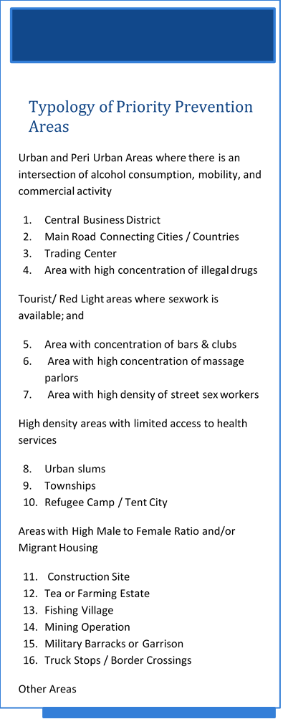
Identify contextual factors
In addition to epidemic indicators based on surveillance, demographic features, and routine program data, the Core Implementation Team identifies contextual factors that may signal the location of PPAs.
These can be mapped using the QGIS PLACE Mapping Tool and used to prioritize districts for PLACE implementation.
Based on their investigation, the Core Implementation Team proposes a typology of PPAs that should be reviewed and finalized by the National Steering Committee.
See Worksheet 4.3 in the Protocol Decisions Manual.
Example to the left is a generic typology of PPA
Notes:
Action: Review and approve the PPA typology (Worksheet 4.3 in the Protocol Decisions Manual).

Slide 30
Update geographic framework with PPAs
Country: name
Metropolitan districts
Subdistrict divisions
Other districts
Subdistrict divisions
Region
Priority Prevention Areas
Priority Prevention Areas
The framework should be adapted to the country and should include the administrative areas in purple and PPAs in teal.
Notes:
This framework should be updated to reflect the country situation. See Worksheet 4.3 in the Protocol Decisions Manual.

Slide 31
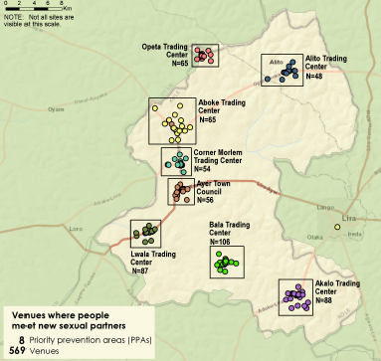
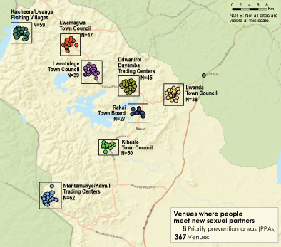
Example of PPAs in a district
Notes:
Source: 25 Districts in Uganda: 2018 PLACE Assessments (https://www.measureevaluation.org/resources/publications/fs-18-322z?searchterm=PLACE+Uganda)

Slide 32

Use the QGIS PLACE Mapping Tool
The PLACE Mapping Tool is designed to help you map strategic information at the district level and use the information to select where to implement PLACE.
Notes:
This description of the QGIS PLACE Mapping Tool is available on MEASURE Evaluation’s website, here: https://www.measureevaluation.org/resources/tools/hiv-aids/place/place-method/the-place-mapping-tool-a-plug-in-for-gis.

Slide 33
Options for selecting districts
Option A
Select all districts.
Option B
Option C
Select districts using a probability method that allows inferences about the districts not selected.
Select districts purposively, without using a probability method.
Notes:
After reviewing available data, the Country Principal Investigator should present a recommendation on whether all areas (called districts in the generic protocol) will be selected (Option A) or not (Option B or C).
If a subset of districts is selected, the recommendation should be to select the districts with a probability method (Option C) to allow extrapolation to areas not selected. See the tools for options on selecting areas.
Option B is often selected if the donor is interested only in specific districts and wants to implement PLACE in all of them.

Slide 34
Use Scorecard tool to select districts under Option C
Choose scoring criteria
Score each district
Sort into high-, medium-, and low-priority strata based on the score
Randomly sample districts in each stratum
One option for selecting a probability sample of districts is to select criteria to score districts and sort the districts into high-, medium-, and low-priority categories, based on the district scores.
Then randomly sample in each stratum.
A spreadsheet tool is provided to select districts using this approach.
Notes:
If the Steering Committee wants to use criteria to score districts, this is a method that can be used. If this method is not an option, don’t present this slide.
The Scorecard tool is in the package of QGIS PLACE materials on MEASURE Evaluation’s website: https://www.measureevaluation.org/resources/tools/hiv-aids/place/place-method/the-place-mapping-tool-a-plug-in-for-gis.

Slide 35
Example: PLACE Uganda 2013
In Uganda, a decision was made to implement PLACE in 25 districts. Option C was used with a scorecard. Then a computer program was used to select districts, oversampling districts with the highest scores but ensuring that all four regions were sampled.
Uganda
National level
Four regions
Central, Western, Northern, and Eastern
111 districts
+ Kampala
25 districts selected with oversampling of high- and medium-priority strata
Notes:
This example can be presented as an option if the plan for selecting areas has not been finalized. For details, see:
MEASURE Evaluation. (2014). Priorities for Local AIDS Control Efforts: Uganda, 2013–2014. Chapel Hill, NC, USA: MEASURE Evaluation, University of North Carolina. Retrieved from
https://www.measureevaluation.org/resources/publications/tr-14-109-en.

Slide 36
Uganda 2013 Scorecard (1)
The scoring system included 10 items, reflecting surveillance data, population size, and contextual factors. Points were given based on the following:
1 point if the district was on a major transport route with a long-distance truck stopover
1 point if it was a border district with a major border crossing
1 point if the district had a municipality or above (reflects larger population/urban center)
1 point if the district had two or more fishing villages (fishing villages have higher HIV prevalence)
1 point if the district had mobile employment clusters evidenced by having at least one fishing village, mine, military camp, road construction, or major plantation

Slide 37
Uganda 2013 Score Card
1 point if the district had sites with PMTCT data showing prevalence among pregnant women 15 to 24 >=10%
1 point if there was low coverage for medical services based on discussions with the Ministry of Health
1 point if the district had the top 10% of the HIV burden in the region
1 point if 10% of mothers with HIV in the region lived in the district (from PMTCT data)
1 point if there was evidence of a substantial increase in HIV prevalence
Districts were sorted into high-, medium-, and low-priority strata based on their scores. In each stratum, a random sample was selected, with oversampling from high- and medium-priority strata.

Slide 38
Document decision on where to implement PLACE
Document the Geographic Framework
Save copies of any maps of surveillance data, program data, and/or contextual factors such as fishing villages and border crossings
Document the chosen option for selecting areas: A, B, or C
Document scoring system, if used
Select areas and document them along with the selection probability for each.

Slide 39
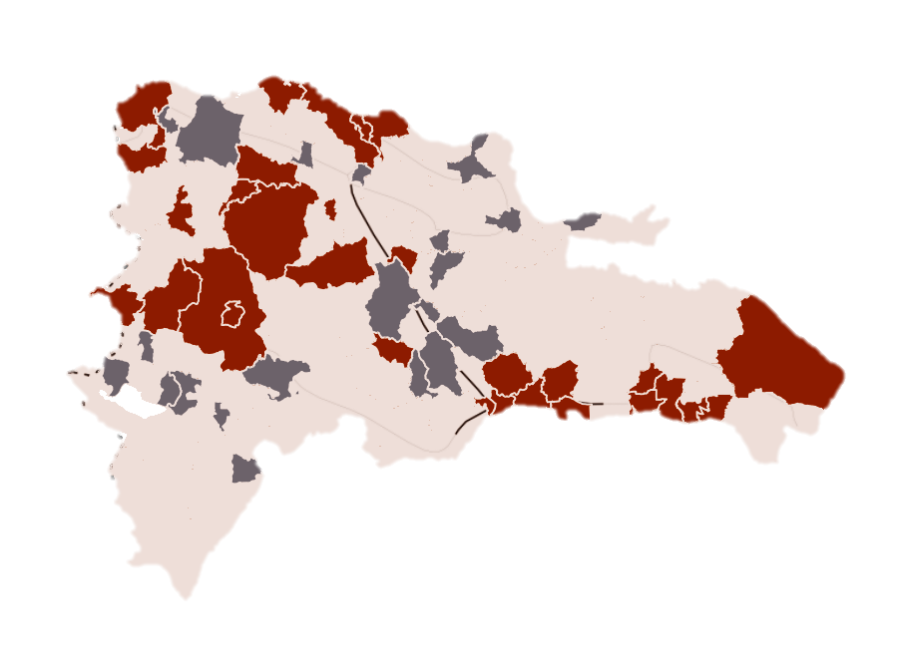
Identify option used and map selected districts
Action: Identify option and map selected districts
Option A
Select all districts
Option B
Option C
Select districts using a probability method that allows inferences about the districts not selected
Select districts purposively, without using a probability method
In this example, districts were chosen using Option C.
Each selected area was mapped, and the probability of its selection was documented on a spreadsheet.
Notes:
The National Steering Committee may want to ensure that a sampling statistician is consulted to document the sampling strategy used to select areas and to ensure that the sampling approach meets the needs of the committee.
Rarely are all areas selected. Consequently, if extrapolation of results is intended for the entire country, it is important to document which areas were selected outright for a specific reason and which areas were selected based on random or stratified random sampling.
Action: The specific sampling probability for each selected area should be documented in a spreadsheet.
List criteria used to select districts
List whether Option A, B, or C was selected
Explain the rationale for the strategy
Provide the list of sampled areas

Slide 40
Conduct district entry visits
After the districts have been selected, a team should visit each one to determine if it is willing to participate and to establish the District Steering Committee.

Slide 41
5. Readiness Assessments

Slide 42
Readiness assessment based on the principle of “do no harm”
Engagement
Risk assessment
Preparation
Nothing about us without us.
Based on current laws, policy, and the environment, what is the risk from mapping?
Is the team prepared if a problem arises?
Ethical review
Has the protocol received review from an ethics committee, such as an institutional review board?

Slide 43
And on principles of safety and data confidentiality
Informed consent
Program improvement
Is a process in place to monitor and address incidents that arise, such as harassment?
Is participation voluntary? Is there a proper process for informed consent?
Does the mapping and size estimation result in program improvement?
Data security
Are safeguards in place to keep the data secure?
Are data use agreements in place?
Incident monitoring
Notes:
A mapping readiness assessment makes sure that people at higher risk for HIV, such as female sex workers and men who have sex with men, are aware of PLACE and understand that their communities will benefit from it. During that assessment, we identify ways to protect those populations and to make sure that no harm comes from identifying places to find these populations.

Slide 44
Readiness assessments (1)
Readiness assessments in each district have these aims:
Assess district support for PLACE
Engage key populations to assess their support and to determine whether harms could arise if PLACE were implemented.
Identify strategies to mitigate risks or dangers
The National Steering Committee may want to attend some of the readiness assessments and/or may want to lead a national-level readiness assessment.

Slide 45
Readiness assessments (2)
PLACE readiness assessments determine the appropriateness, readiness, and safety of conducting PLACE within a district. The Protocol Decisions Manual and its supplementary materials in the PLACE Tool Kit online offers the following support:
Readiness Assessment Tool with a set of questions for stakeholders representing key populations and a set for service delivery providers in the district to be surveyed
Guidance for gathering the information needed to identify collaborating partners, describe the key populations that will be mapped, assess the local legal environment, and identify data safety and security procedures
Worksheets to help organize information-gathering

Slide 46
Readiness assessments
  Stakeholder consultation guides to gather input from key populations/key population representatives, healthcare and service providers, and mapping team members
  Questions for key populations about the types of venues where people meet new sexual partners or people who inject drugs can be reached.
  Summary tables to describe each risk identified and create a plan for addressing each risk.

Slide 47
Venues: typology
Venue with alcohol or beds Formal bar 1 Informal bar 2 Nightclub/disco 3 Truck stop 4 Brothel 5 Rest house/guesthouse 6 Hotel/motel 7 Massage parlor 8 | Outdoor venues Street with sex work 9 Beach/lake/river 10 Yard/field/bush 11 Street 12 Park 13 Construction site 14 Port/harbor 15 Bus/train/taxi stop 16 | Other venues/events Restaurant 17 School/campus 18 Shopping mall/shop 19 Other physical venue 20 Cultural events 21 Sports event 22 Market day event 23 Other event 24 | Internet and social media Internet site 25 Social media app 26 Private (excluded) venues Telephone number 27 Private home/ parties 28
Action: This is the generic list of the types of venues where people meet new sexual partners or where people who inject drugs can be reached. Review and adapt to your setting.
Notes:
This list is in PLACE Form A: Questionnaire for Community Informants, in the PLACE Tool Kit online.

Slide 48
Use findings to design the study’s protocol
Findings from the readiness assessment should be used to adapt the protocol, so it is acceptable to key populations, does not pose risks, reflects the type of venues that key populations identify, and will be supported by service providers in the area.
The National Steering Committee should replace districts that decline participation and districts with safety issues that cannot be resolved.
For example, in Malawi, two districts were replaced because of unrest in the district over HIV testing. In Uganda, one district was replaced because of a concurrently implemented large sex worker survey there.

Slide 49
6. Study Design and Methods

Slide 50
Overview
Review 5 steps of PLACE
Define survey populations
Recruit respondents
Define key populations
Review ethical issues and informed consent

Slide 51
Fieldwork phase: 5 steps
All 5 steps of PLACE are required for estimating prevention and treatment cascades.
Step 1
Step 2
Step 3
Step 4
Step 5
District launch and identify PPAs
Identify venues
Visit and map venues
Conduct biobehavioral survey
Feedback and data use workshop

Slide 52
Define survey populations
Objective: To define the populations who will be interviewed or tested
Level 1: The community informants who identify venues where people meet new sexual partners or where people who inject drugs can be reached. Use Form A.
Level 2: Venue informants who provide information on one venue. Use Form B.
Level 3: Venue workers and patrons who are interviewed about their own behavior and tested for HIV infection. Use Form C.
Notes:
Forms A, B, and C are included in the PLACE Fieldwork Implementation Guide and are also available as discrete files in Word and pdf in the PLACE Tool Kit, online.

Slide 53
Level 1: Community informants
Use the Form A questionnaire.
Community informants are adults ages 18 and older who are knowledgeable about where people go to meet new sexual partners or where people who inject drugs can be reached.
Community informants can be taxi drivers, foodstand sellers, teachers, transport workers, alcohol sellers, people loitering in the streets, security guards, and public officials, such as police.
Action: The National Steering Committee should review the generic list of community informants and adapt it to the country.

Slide 54
Examples of community informant codes
1 Taxi driver
2 Truck driver
3 Bar owner or worker
4 Individual socializing at site
5 Security guard/car guard
6 Transgender person
7 Person who injects drugs
8 Man who has sex with men
9 Woman who sells sex for money
10 Hairdresser
11 Community leader
12 Youth in school
13 Youth out of school
14 Military/police
15 Community-based organization/
nongovernmental organization staff
16 Peer educator
17 Community health worker
18 Trader/businessperson
19 Hawker/street vendor
20 Unemployed/person loitering
21 Fishermen
22 Boda boda driver
23 Other:
24 Other:
25 Other:
26 Other:
27 Other:
28 Unassigned
Notes:
These codes are in Form A.

Slide 55
Level 2: Venue informants
Use the Form B questionnaire.
No adaptation is necessary.
General venue informants are adults ages 18 and older who are at the venue at the time the PLACE Fieldwork Team collects information on-site about the venue.
The person can be a patron, a key population member socializing at the site, a security guard, or the venue owner or manager.
One general venue informant is selected by the interviewers per venue, based on the respondent’s ability to provide information about what occurs there, the people who visit the venue, and HIV prevention activities occurring on-site.
Venues are physical venues, events, and websites.

Slide 56
Level 3: Patrons and workers
Patrons and workers are recruited at the venues selected for Level 3 interviews using Form C.
Workers are people who work at the venue. They are routinely found to be at high risk. All workers at selected venues can be recruited to participate.
Patrons are people who are socializing at the venue. They are recruited using a probability sample.
Workers and patrons can include all people 18 and older as well as people 15−17 years if they are at the venue independent of their families.

Slide 57
Informed consent
Review the approach for informed consent and adapt it as necessary.
 | Age | Consent method | Anonymous | Fact Sheet Offered | Incentive Payment
Community Informants | 18+ | Voluntary, Verbal | Yes | Yes | Benefit of HIV Test
Venue Informants | 18+ | Voluntary, Verbal | Yes | Yes | Benefit of HIV Test
Patrons and Workers | 18+ 15−17 if not with their parents | Voluntary, Verbal | Yes | Yes | Benefit of HIV Test

Slide 58

Key populations: Definitions
Key populations are included in PLACE surveys, but the questions used to define whether someone is a member of a key population should be reviewed to ensure that the questions are aligned with national definitions and indicators.
PLACE definitions for four key populations follow.

Slide 59

Men who have sex with men (MSM)
PLACE defines a man who has sex with men as a man who reports anal sex with a man in the past 12 months.
MSM may self-identify as being gay, homosexual, or bisexual.
Transgender women are not included in the category of MSM.
Notes:
Note: If MSM are not a focus, delete this slide.
Read slide.
Note: Can discuss locally used terms for MSM.

Slide 60

Transgender people
Transgender people identify with a different gender than the one they were assigned at birth.
Transgender women were born male but self-identify now as women.
In some cases, transgender people get hormone injections to change their appearance.
Transgender women can have sex with men, women, or both.
Notes:
Note: If transgender persons are not a focus, delete this slide.

Slide 61
People who inject drugs
People who report injecting a nonprescription drug, such as heroin, are considered people who inject drugs.
They are asked whether they share needles or syringes.
People who get medical injections or vaccinations are not considered a key population.
People who USE drugs, such as marijuana or alcohol, can have risky behaviors, but are not considered people who inject drugs.
Notes:
Note: If people who inject drugs are not a focus, delete this slide.

Slide 62
Women who have sex for money
Often referred to as female sex workers.
PLACE defines female sex workers as women who have had sex for money in the past 12 months.
PLACE also asks about sex in exchange for goods, favors, or services, but size estimates and characteristics of sex workers are usually limited to those who have exchanged sex for money in the past 12 months.
Notes:
Note: If female sex workers are not a focus, delete this slide.

Slide 63

Key populations: Oversampling
Key populations may not be included in a sufficient number to provide precise estimates of their characteristics and HIV prevalence.
To obtain more precise estimates, a strategy to oversample key populations can be implemented.

Slide 64
Oversampling key populations
Common key populations and priority populations:
Female or male sex workers
MSM
People who inject drugs
Transgender people
Girls ages 15−19 years
Women who live at venues
Male clients of sex workers
Street-based female sex workers
Transportation workers
Mobile people
Action: Determine which key populations and priority populations are of greatest importance in the HIV epidemic and warrant the additional cost of oversampling or special recruitment to reach a sufficient sample size to achieve adequate precision for estimates of population size, HIV prevalence, risk factors, or cascade indicators.

Slide 65
7. HIV Testing

Slide 66
Overview
Identify the specific tests that will be offered.
Review process of collecting specimens and providing results.
Determine how people with a positive HIV test will be linked to ART if they are not already receiving ART.
See the Fieldwork Implementation Manual Step 4 for a step-by-step option for getting informed consent, testing, and returning results.
Establish quality control procedures.

Slide 67
General principles
Testing is voluntary.
Testing is conducted by trained personnel.
Often testers are local Ministry of Health staff given an extra stipend.
The protocol for PLACE is aligned with national protocols and reporting HIV+ test results is the national process.
Linkage to care follows national guidelines.
Test results are collected for the respondent but not any identifying information.

Slide 68
Recommended tests
Tests | Used for:
HIV antibody test | HIV prevalence
Dried blood spots collected from HIV-positive people:
1. Tested for viral load | Cascade: suppressed
2. Tested for evidence of antiretroviral therapy | Cascade: on treatment

Slide 69
Other testing options used in PLACE studies
Gonorrhea (rectal, vaginal)
Chlamydia (rectal, vaginal)
Syphilis
Malaria
Vitamin A deficiency
Phylogenetic clusters of HIV
Trichomonas

Slide 70
8. Quality Assurance and Safety

Slide 71
Overview
Identify the quality checks that will be performed.
Review training materials to ensure that key topics are covered sufficiently.
Review safety protocols for the study team.

Slide 72
Importance of data quality
One of the pillars of the PLACE method is scientific rigor.
A key ingredient of scientific rigor is careful implementation of the protocol.
Missing or incomplete data or documentation can make interpreting a PLACE study impossible.
The Fieldwork Implementation Guide includes several forms to document implementation of PLACE.

Slide 73
A full pilot of the protocol
Often people decide to cuts costs or shorten the implementation time by minimizing the importance of a full pilot of the protocol.
We encourage people to fully implement the protocol using all training and fieldwork forms so that problems can be identified.
A full pilot of the protocol is a useful way to train supervisors and assistant supervisors.
During the full pilot, all translations and skip patterns and tablet issues can be identified and fixed. Pilots save time!

Slide 74
Training
Shortcuts are often taken in training.
The Fieldwork Implementation Guide includes agendas for training and PowerPoint presentations for training sessions.
Training should be conducted just prior to data collection so that the training is not forgotten.
The guide also offers quality checklists for each step.

Slide 75
9. Sampling and sample size

Slide 76
Guidance
Set quotas for the number of community informant interviews.
Select option for sampling venues to visit and venues for the biobehavioral survey.
Specify how female workers and male and female patrons will be sampled for the interview and testing.
Specify if and how key populations and priority populations will be oversampled.
Ensure the sample size is large enough to ensure adequate precision.
Document the sampling design.

Slide 77
Sampling recommendations
Level 1: Community informants
Use quota sampling.
Experience suggests that interviewing 30 community informants per population of 20,000 people ages 15−49 provides a complete list of venues in the area.
During implementation, the team should determine whether additional informants should be interviewed to achieve saturation.

Slide 78
Community informant targets
District | District population ages 15-49 | Number of clusters of 20,000 people ages 15-49 | Target number of community informant (CI) interviews (30 CI interviews per cluster of 20,000 people)
A | 200,000 | 10 | 300
B | 500,000 | 25 | 750
C | 1,000,000 | 50 | 1,500

Slide 79
Sampling recommendations
Level 2: Venue informants
1 venue informant per venue
District | Number of venues identified | Minimum number of venues to visit
A | 300 | 300
B | 750 | 450 (60% of 750)
C | 1,500 | 900 (60% of 1500)

Slide 80
Master Venue List (1)
Community informants name venues along with their address and some basic characteristics.
The list of venues is entered in MS Excel. This list is called the Master Venue List.
The Master Venue List serves as the sampling frame for sampling venues to visit to characterize the venue using Form B and to subsequently select venues where the interviews and tests will be conducted.
Notes:
A Master Venue List template in MS Excel is available in the PLACE Tool Kit, online.

Slide 81
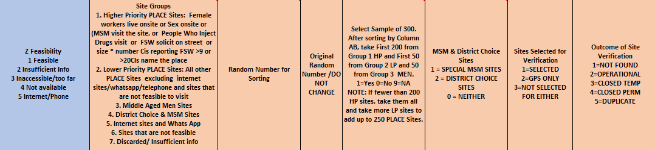
Master Venue List (2)
A spreadsheet – the Master Venue List – is provided to facilitate sampling.
The spreadsheet can be adapted to the sampling strategy defined in the protocol.
Above is a section of the Master Venue List used in 25 districts in Uganda in 2013.

Slide 82
Sampling venues for mapping and Level 2 interviews
The Master List of Venues can be used to select the venues to visit. There are 3 options.
Option A
Select all venues
Option B
Option C
Select a stratified random sample of venues
Select an interval random sample of venues

Slide 83
Option A: All venues
The recommended approach (Option A) is to visit all venues that are feasible to visit and interview a venue informant at each venue. Visiting each venue ensures that a map of venues will be completed and facilitates outreach to venues by prevention programs.
Social media venues are also visited.
If there are fewer than 300 venues per selected area, all venues should be visited.

Slide 84
Other options
Option B
If there are financial or logistical constraints, select a random sample of 300 or more venues.
Option C
If there are financial or logistical constraints, select a stratified random sample of venues, with oversampling of high priority venues.
Option A
Select all venues
Option B
Option C
Select a stratified random sample of venues
Select an interval random sample of venues

Slide 85
Option C requires prioritizing venues. Here is an example:
1: Higher priority
Female workers live on-site
2: Lower priority
All remaining physical venues
3: Social media sites
Social media venues include websites and telephone applications
MSM visit venue
People who inject drugs visit venue
10 or more community informants reported that sex workers visit the venue
Sex occurs on-site
20 or more community informants reported the venue

Slide 86
Sampling venues by strata: General recommendations
Exclude the few events and venues that are not feasible to visit.
Determine if each feasible event and venue is higher or lower priority.
Oversample a higher-priority stratum relative to a lower- priority stratum (for example, in a 3:1 ratio, 90% versus 30%).
In addition, randomly select 30 social media sites.
1 Higher priority
Sex occurs onsite
2 Lower priority
All remaining feasible venues
3 Events
4 Social media sites
Social media venues include websites and telephone applications
MSM visit venue
People who inject drugs visit venue
More than 10 community informants reported that sex workers visit the venue
More than 20 community informants reported the venue
Events with sex work or MSM or sex on site or people who inject drugs
All remaining feasible events
Assign feasible events to higher or lower priority stratum

Slide 87
High-priority vs low-priority venues
 | Proportion of high-priority venues selected | Proportion of low- priority venues selected | Comments
Example 1 | 100% | 50% | This has the advantage of including all high-priority venues.
Example 2 | 60% | 30% | If the number of high-priority venues is more than can be feasibly visited, then visiting a sample of them may be required.
Example 3 | 50% | 50% | This is the same as interval sampling.

Slide 88
Using the Master Venue List: Tips
To adapt the Master Venue List for a particular PLACE study:
Read the instructions on the first tab of the MS Excel template provided in the PLACE Tool Kit.
Confirm how many venues you want to select for Form B and Form C and practice using the spreadsheet to select those samples.
Identify one person to draw the samples. All sampling should be documented and the venue list saved. Fieldwork supervisors should not draw the sample.

Slide 89
Sampling venues for a biobehavioral survey
Stage 2
From among the venues selected above, select 30 for the biobehavioral survey.
Stage 3
Stage 1
Select venues to visit for Level 2 interviews.
On arrival at the venue, select patrons and workers to interview.

Slide 90
Key populations (1)
If the National Steering Committee wants separate indicators for key populations, additional interviews of male and female patrons may be needed.
Key populations may not be sufficiently represented in a simple cross-sectional sample of people socializing at the selected venues. If the cross-sectional sample is expected to provide fewer than 200 people meeting the definition for membership in the key populations of interest, then additional interviews should be conducted to reach the target of 200 interviews per key population.

Slide 91
Key populations (2)
One strategy is to complete the regular PLACE interviews at a venue, count the number of key population members who have been interviewed, and if more are required, use a screening form to identify people at the venue who meet the criteria for the key population. The sampling weight for these add-on interviews is usually based on the proportion of those screened who meet the criteria for a key population.

Slide 92
Ensure the sample size is large enough
A rule of thumb is to interview all female worker and at least 300 men and 300 women at 30 or more venues selected using a probability sampling method.
Assuming a design effect of two, interviewing 600 patrons at 30 venues provides sufficiently precise indicators for most public health programs.
See Section 9 of the PLACE Protocol Decisions Manual.

Slide 93
10. Key Indicators

Slide 94
Guidance
Confirm venue typology, profiles, and maps.
Review patron and worker indicators.
Review the 3 questionnaires:
  Form A : Community informant interview to identify venues
  Form B: Venue informant interview to describe venues
  Form C: Biobehavioral survey to describe patrons and workers
Review and confirm Key Population indicators
Review national level indicators

Slide 95
Venue profile elements in Form B
General information
Venue name
Venue identification number
Date of visit
Type of venue
Location
Number at busy time
Male and female workers
Male and female patrons
Women living onsite
Onsite risk activities
Busy days and times
Sex onsite
Person helps patrons find sex partners
Risk of sex workers available
Alcohol consumption
Exotic dancing
Erotic massage
Injecting drug use
Prevention services
Free condoms
Condoms for sale
Free lubricants
Lubricants for sale
HIV prevention posters
Outreach HIV testing
Peer education
HIV posters
Female sex workers
MSM
People who inject drugs

Slide 96
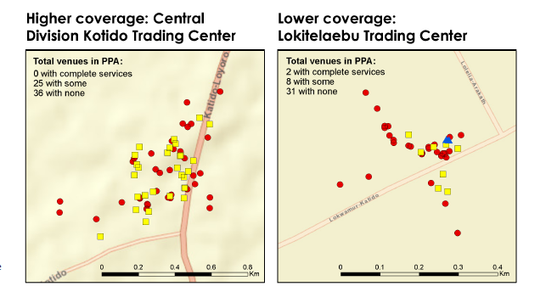
Venue maps
Map of venues by venue type and priority
Map of condom availability at venues
Map of HIV prevention outreach at venues

Slide 97
Form C indicators and biomarkers
PLACE has a standard set of indicators that can be adapted to fit program needs. See the following slides. Changes may not be necessary.
Biomarkers: HIV tests and other options
Indicators
Patron and worker profiles
Key population profiles
Cascade indicators
District yield

Slide 98
Patron and worker profiles
Socio-demographic characteristics
Age
Proximate determinants
Sex/gender
Current marital status
Educational attainment
Employment status
Type of employment
Student status
Area of residence
Length of time in area
Where slept last night
Access to mobile phone
Social media use
Sex born as/gender now
Sexual partnership rates
Anal sex
Needle sharing
Condom use
Lubricant use
HIV
HIV prevalence
HIV treatment cascade
Vulnerability and adverse events
Sex work
Use of services
HIV testing
Lubricants
Peer education
Drug use
Alcohol consumption
History of jail/prison
History of rape, violence
History of stigma
Circumcision
Condoms
Sexually transmitted infection screening
Need for services
Size of population
Prevention cascade
Treatment cascade

Slide 99
Key population profiles
No additional questions are required on the questionnaire.
Responses to the questions are used to determine who is a member of which key population.
Then the biobehavioral survey indicators are estimated for each key population separately, using appropriate sample weights.

Slide 100
Key population profiles: Variables that define membership
Socio-demographic characteristics
Age
Proximate determinants
Sex/gender
Current marital status
Educational attainment
Employment status
Type of employment
Student status
Area of residence
Length of time in area
Where slept last night
Access to mobile phone
Social media use
Sex born as/gender now
Sexual partnership rates
Anal sex
Needle sharing
Condom use
Lubricant use
HIV
HIV prevalence
HIV treatment cascade
Vulnerability and adverse events
Sex work
Use of services
HIV testing
Lubricants
Peer education
Injection drug use
Alcohol consumption
History of jail/prison
History of rape, violence
History of stigma
Circumcision
Condoms
Sexually transmitted infection screening
Need for services
Size of population
Prevention cascade
Treatment cascade
Notes:
To analyze key population data, the survey data set is limited to people who meet the definition of key population.

Slide 101
Example: HIV prevalence by sex, Uganda PLACE, 2018
Sex | N | N HIV + | Prevalence | 95% CI
Male
Unweighted | 9,872 | 440 | 4.5 | 4.0 | 4.9
Weighted | 298,496 | 13,293 | 4.5 | 3.9 | 5.0
Female
Unweighted | 4,301 | 393 | 9.2 | 8.0 | 10.3
Weighted | 116,248 | 10,223 | 8.8 | 7.4 | 10.2
Transgender women
Unweighted | 126 | 13 | 10.3 | 4.6 | 16.1
Weighted | 3,211 | 365 | 11.4 | 3.7 | 19.0
Notes:
Source: MEASURE Evaluation. (2018). PLACE Assessments in Uganda. [Website]. Chapel Hill, NC, USA: MEASURE Evaluation, University of North Carolina. Retrieved from
https://www.measureevaluation.org/resources/tools/hiv-aids/place/uganda/place-assessments-in-uganda

Slide 102
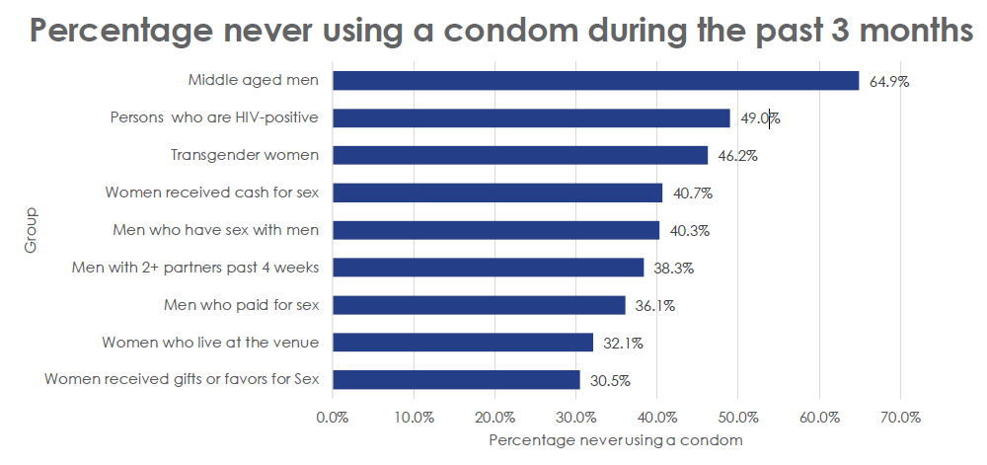
Example: Condom use by group, Uganda PLACE, 2018

Slide 103
Actionable data at the district level
Simple
List of venues
Maps of venues
Characteristics of HIV-positive people
Condom availability at venues
Program coverage, by type of person

Slide 104
HIV and cascade estimates
Data can be used to estimate HIV prevalence and HIV treatment cascades for each district.

Slide 105
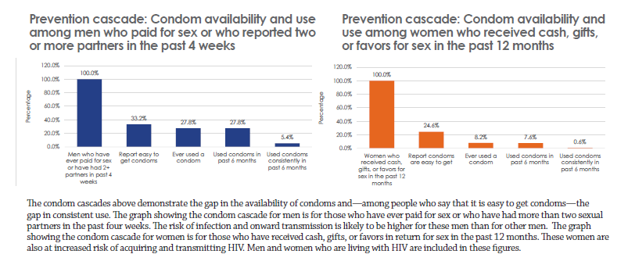
Prevention cascades: Condoms

Slide 106
Prioritize outreach and estimate yield
District scorecards can estimate the number of people living with HIV who are not on treatment in each PPA.
Data can prioritize venues or types of people for outreach.

Slide 107
If changes are necessary…
Be sure to update the questionnaires to reflect the changes.
Changes in the indicators may require changes in the questions and the codes used in the responses.

Slide 108
Paper or tablets for data collection?
General recommendation:
For Form A: Use paper forms to collect data.
For Form B: Use a tablet or other device that can record the latitude and longitude.
For Form C: Use a tablet or other type of computer.
Translate the forms into all common languages.

Slide 109
11. Statistical Analysis

Slide 110
Guidance
Describe analysis methods.
Describe population size-estimation methods.

Slide 111
Analysis plans should describe:
Methods for estimating indicator
Tables that will be produced
Strategies for weighting the sample if necessary
Methods for size estimation of key populations
Estimates should take into account:
  Stratification during sampling
  Clustering of samples within venues
  Weights—differences in the probability a person is selected

Slide 112
12. District Reports

Slide 113
Guidance
Report template is provided for displaying findings to decision makers
Template helps committee to summarize findings by district
Template helps with formulating an executive summary
Report template gives examples and guidance on incorporating tables, graphs, and maps

Slide 114

Report template
Notes:
The District PLACE Report Template can be used to produce a final report, once all PLACE study fieldwork has been completed. The template is available in the PLACE Tool Kit, online.

Slide 115
Examples of executive summary sections in a report
What is the PLACE method and how was it developed?
How will the results be used?
How was this district (or were these districts) selected for a PLACE study?
Where do people meet new sexual partners?
Do people use condoms consistently?
What is the prevalence of HIV?
What are the gaps in prevention?

Slide 116
Examples of other sections in a PLACE report
PLACE indicators
District characteristics
Fieldwork summary
Maps showing venue locations and characteristics (i.e., condom availability, type of venue)
Key population characteristics and behaviors at venues
HIV prevalence and treatment cascades

Slide 117
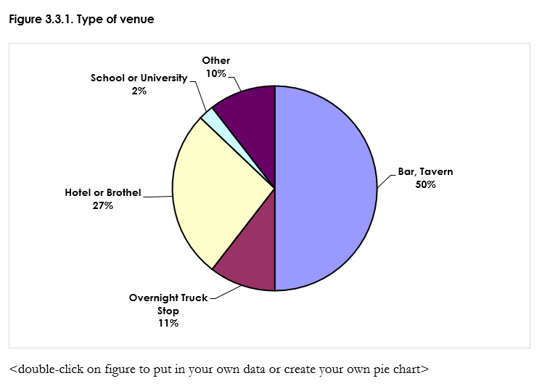
Examples of other sections in a PLACE report (1)

Slide 118
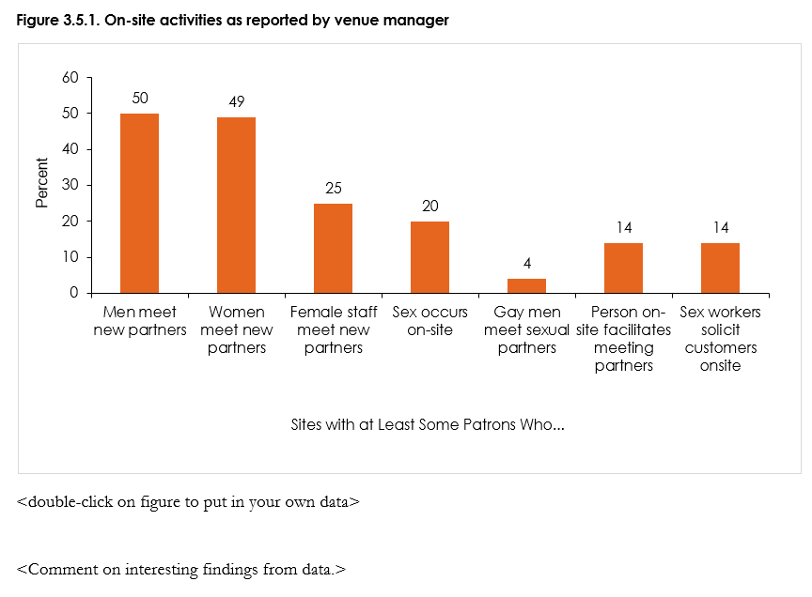
Examples of other sections in a PLACE report (2)

Slide 119
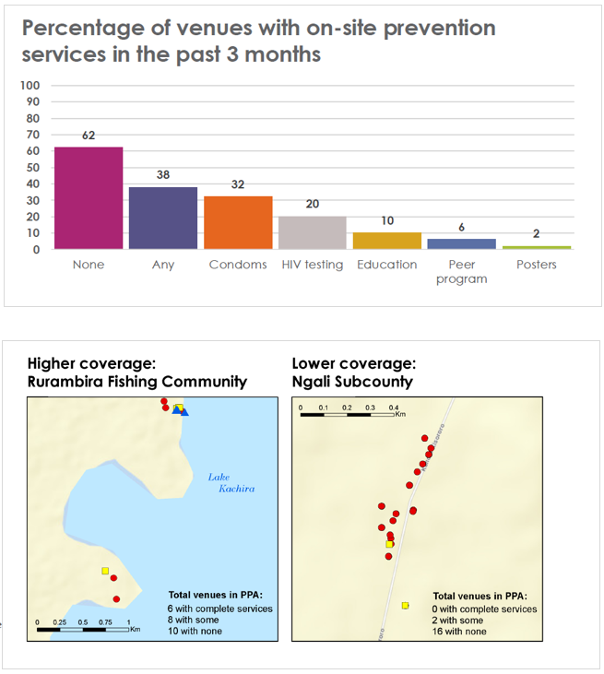
Examples of other sections in a PLACE report (3)

